Slide 1

IoT-Based air quality MONITORING system presented by : ritika

Slide 2
introduction:
An air pollution monitoring system is a network of instruments that continuously measure and report on the presence and concentration of pollutants in the air. These systems help in identifying the sources of pollution and assessing the effectiveness of pollution control measures.
They can also be used to alert the public to dangerous air quality levels, allowing for protective actions like wearing masks or staying indoors.

Slide 3
IMPORTANCE:
IoT paradigm has increased the interest in monitoring and study of air pollution and its consequences on human health, thus evaluating its impact in life forms as well as environmental damage
Application of IoT-based systems, emphasizing their role in enabling real-time, precise air quality assessment across various sectors, including urban, industrial, and agricultural environments.

Slide 4
FEATURES:
Air pollution monitoring systems are designed to measure various pollutants and other parameters in the air to assess and ensure the quality of the air we breathe. These air quality measurement devices typically consist of several components.
Air quality systems have sensors and software to check pollutants like PM, NO2, SO2, CO, O3, and VOCs. So, they work in real-time.
IoT base Air Quality Monitoring System calculate how much pollution is there and make warnings and pollution levels are too high and could be harmful.

Slide 5
IOT TECHNOLOGY:
IoT can be deﬁned as a networking infrastructure that connects uniquely identiﬁable objects to the Internet. These objects are usually sensor or actuators with smart capabilities. Information about these objects can be collected.
IoT is about leveraging the power of data and connectivity to make our lives easier, more efficient, and more convenient. By connecting everyday objects to the internet, IoT enables us to remotely monitor and control them, gather valuable insights, and automate tasks.

Slide 6
REQIREMENTS:
HARDWARE REQUIREMENTS:
Arduino UNO
Breadboard
LM35(Temperature Sensor)
Gas Sensor
Red ,Green LED
16*2 LCD Display
Jumper Wires
Resistors
SOFTWARE USED:
Tinkercad

Slide 7
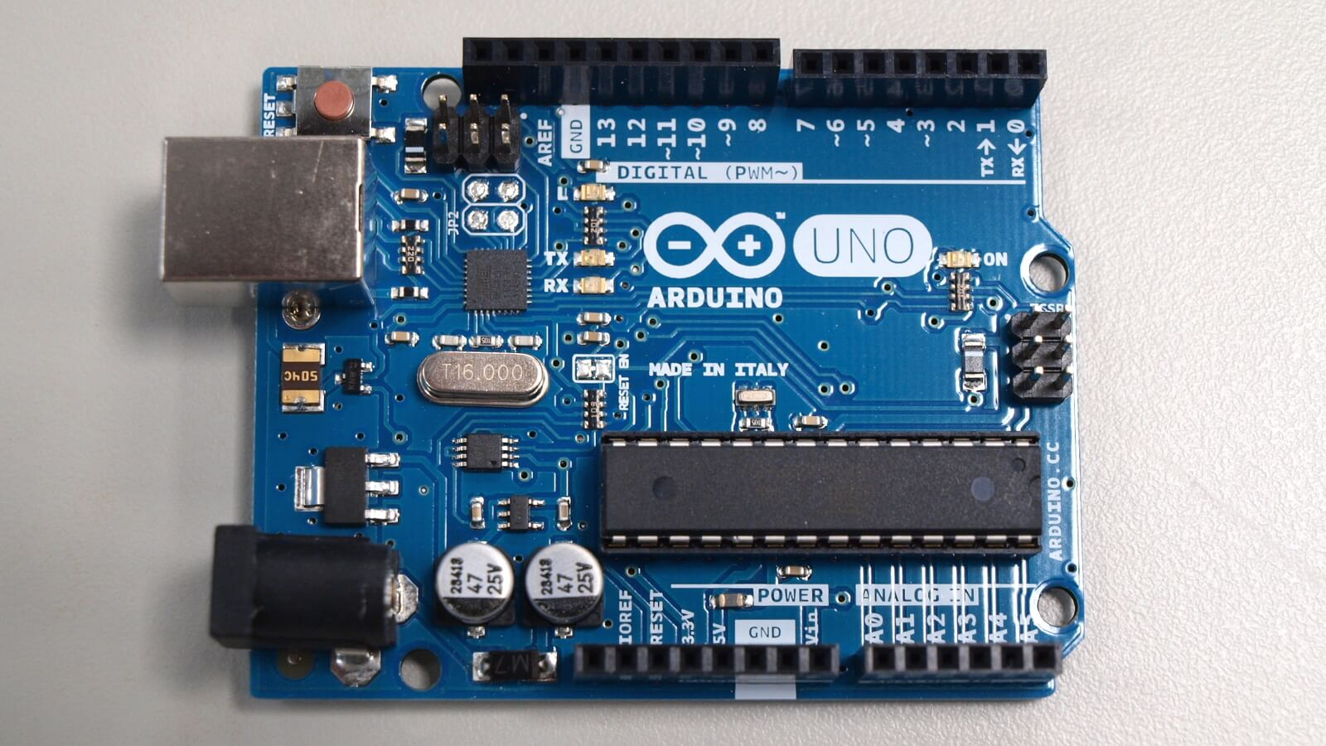
Arduino uno

Slide 8
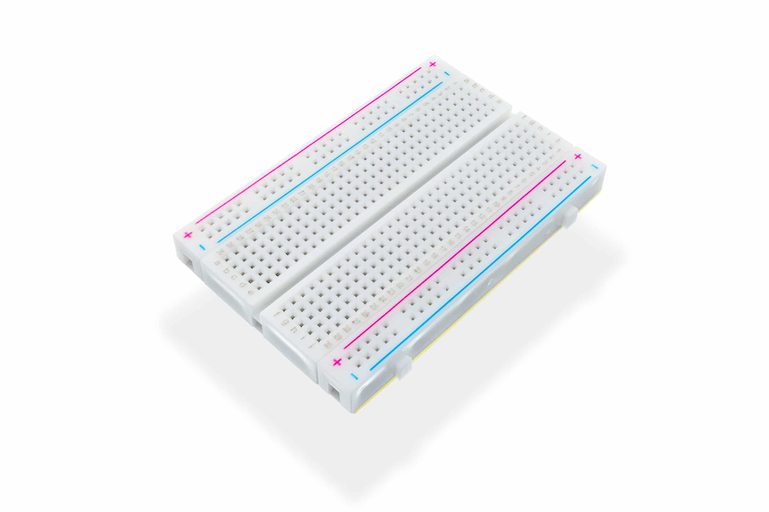
breadboard

Slide 9
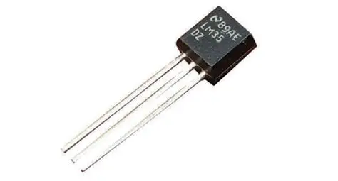
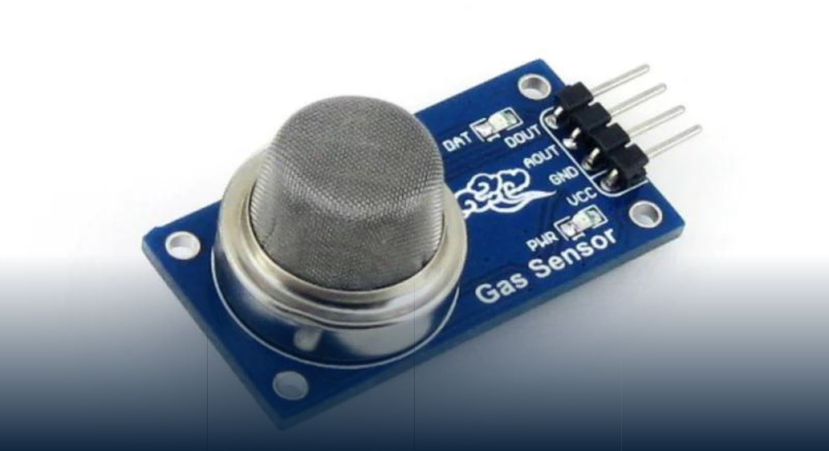
Lm35 sensor gas sensor

Slide 10
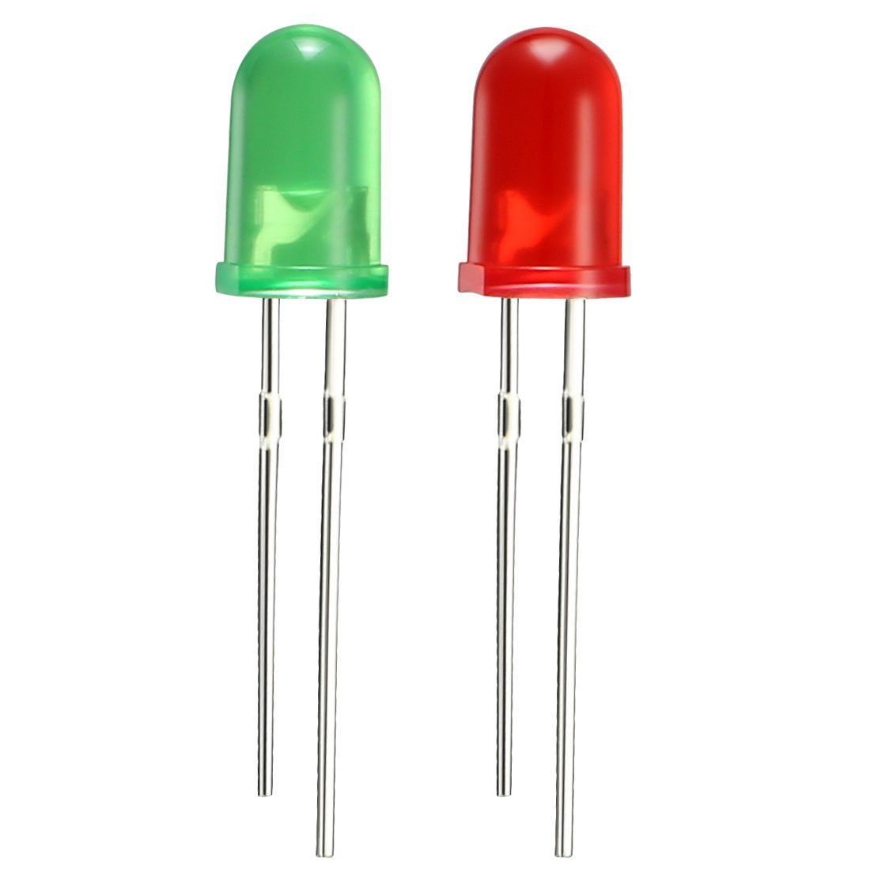
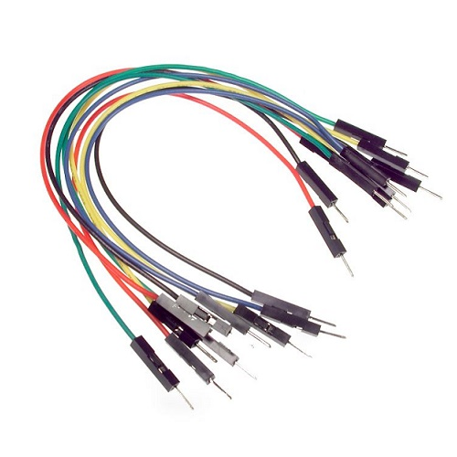
Led(green ,red) jumper wires

Slide 11
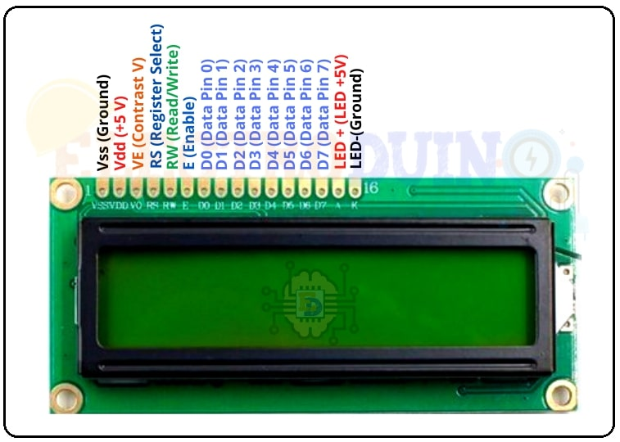
16*2 lcd dISPLAY

Slide 12
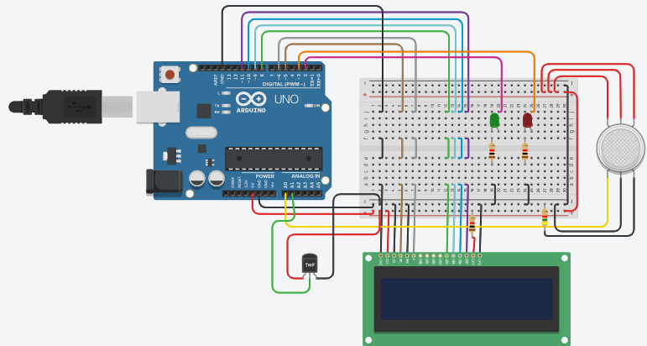
circuit DIAGRAM

Slide 13
Working principle:
Gas Sensor : Air quality monitoring system used Gas Sensor detects presence of a gas in an environment
by measuring the electrical properties of the air.
LM35 Sensor:LM35 Sensor Measure Temperature.
Microcontroller: The system gathers information from the sensors using Arduino UNO to collect and analyze the sensor readings.
LEDs: Green LED will glow if the air quality is safe while red led indicates that the pollution level is too high and could be harmful.
LCD Display : The analyzed data is shown through LCD display. It tells them about the air quality and temperature.
Implementation using Tinkercad : Tinkercad is used to implement it. This software can figure out what the sensor readings mean. As well as calculate how much pollution is there and make warnings through red led if pollution levels are too high and could be harmful.

Slide 14
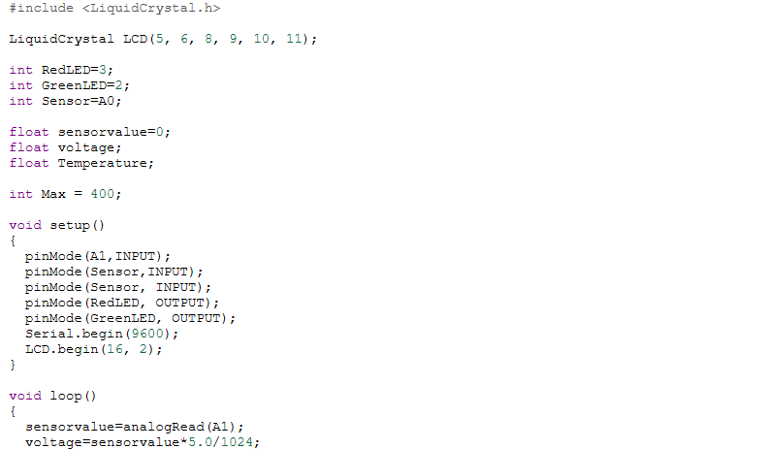
CODE:

Slide 15
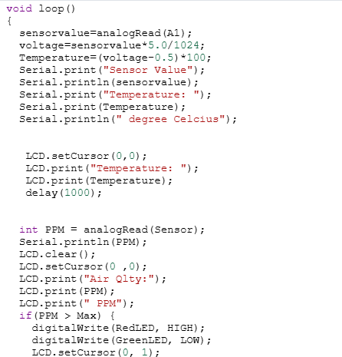

Slide 16
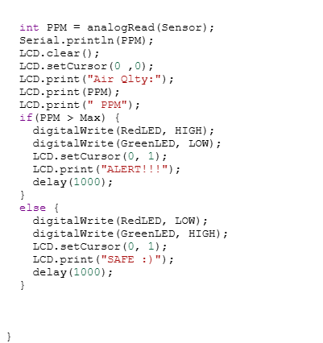

Slide 17
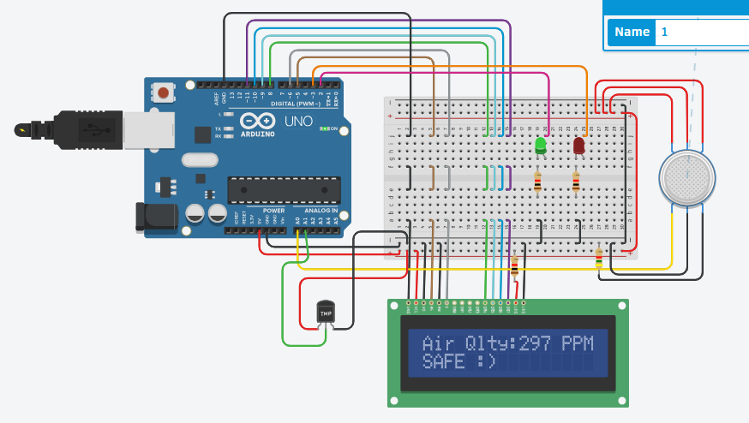

Slide 18
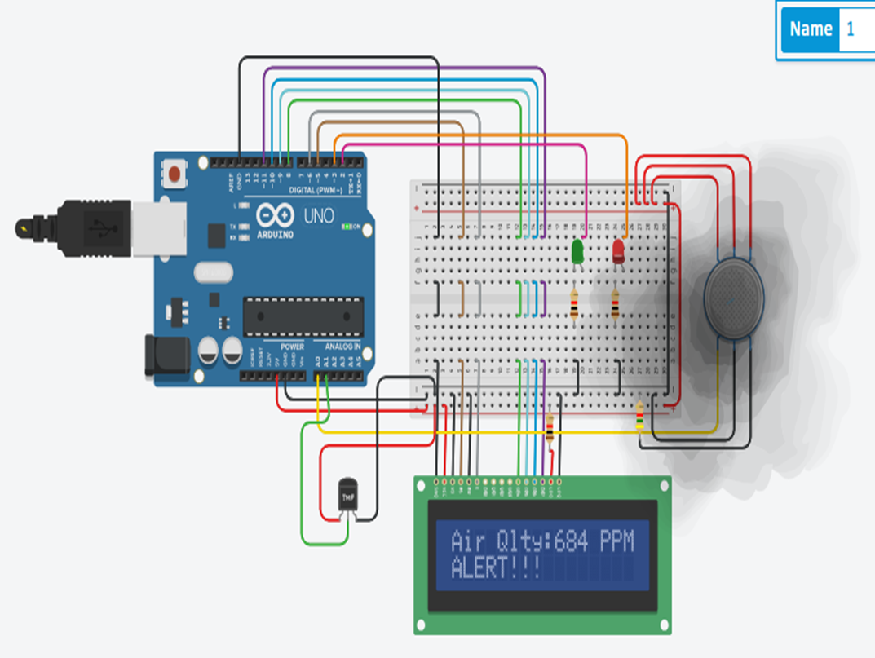

Slide 19
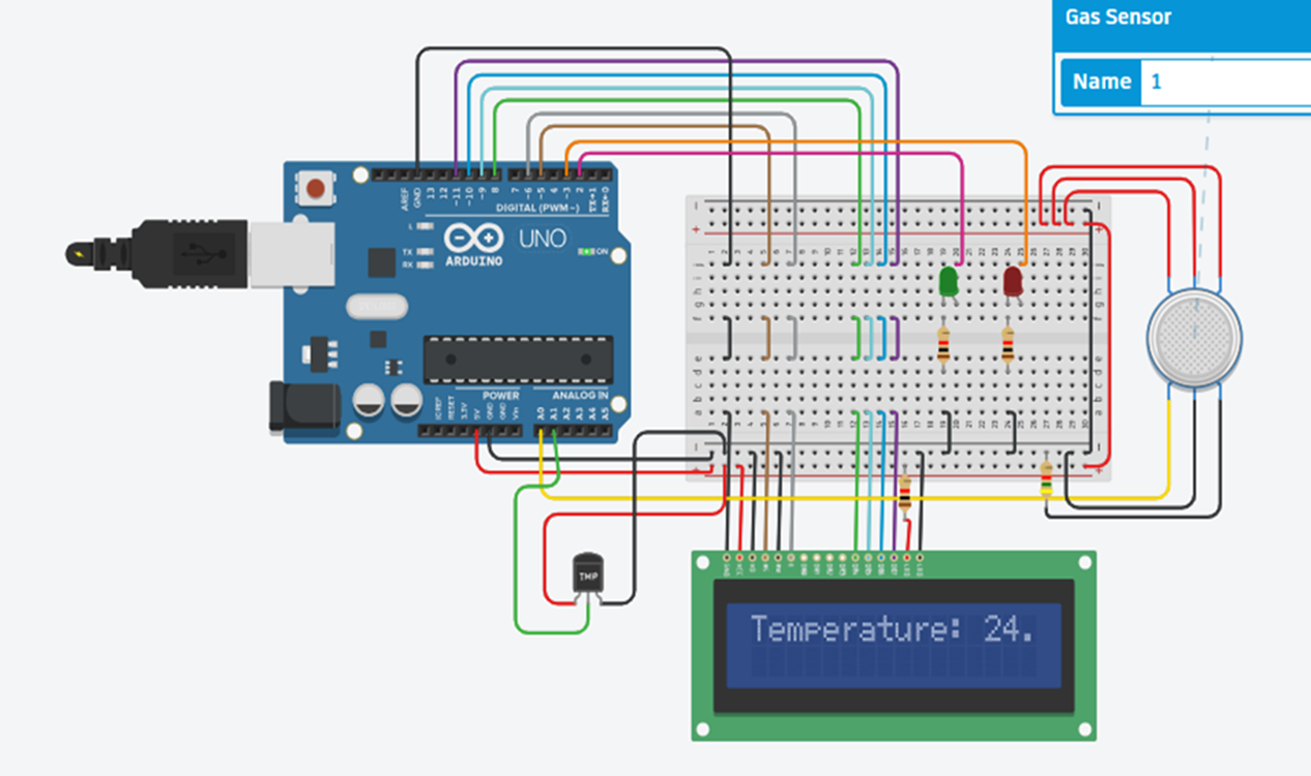
OUTPUT:

Slide 20
Applications:
Roadside Pollution Monitoring
Industrial Perimeter Monitoring
Site Selection for reference monitoring stations
Indore Air Quality Monitoring

Slide 21
Future scope:
The future of air quality monitoring systems is promising, with advancements in technology and increasing awareness driving growth and innovation. Key trends include the integration of AI and machine learning, expanded use of mobile and drone-based monitoring, and deeper integration with smart city infrastructure.

Slide 22
CONCLUSION:
IoT technology offers a promising solution for addressing the challenges of pollution monitoring. By leveraging a network of interconnected sensors, IoT devices can provide real-time, accurate, and widespread data on various pollutants.
This information can be used to inform policy decisions, improve environmental management, and protect public health. While there are still challenges to overcome, such as sensor reliability, data security, and network connectivity, the potential benefits of IoT-based pollution monitoring make it a worthwhile investment for governments and organizations.

Slide 23
Thank you

